Slide 1
Chapter 5 Trees

Slide 2
Outline
Introduction
Binary Trees
Binary Tree Traversals
Additional Binary Tree Operations
Threaded Binary Trees
Heaps
Binary Search Trees
Selection Trees
Forests

Slide 3
5.1 Introduction

Slide 4
5.1.1 Terminology
The pedigree chart of Figure 5.1(a) shows someone’s ancestors.
Dusty
Honey Bear
Brandy
Brunhilde
Terry
Coyote
Nugget
Gill
Tansey
Tweed
Zoe
Crocus
Primrose
Nous
Belle
Figure 5.1(a): Pedigree

Slide 5
5.1.1 Terminology
The lineal chart in Figure 5.1(b) describes the ancestry of the modern European languages.
Proto-Indo-European
原始印歐語系
Italic
古希臘語
Hellenic
Germanic
日耳曼語
Oscan-Umbrian
Latin
Greek
North
West
Oscan
Umbrian
Spanish
French
Italian
Icelandic
Norwegian
Swedish
Low
High
Yiddish
意大利中部
的一種語言
冰島語
挪威語
瑞典語
意第緒語
Figure 5.1(b): Lineal

Slide 6
5.1.1 Terminology
Intuitively, a tree structure means that the data are organized in a hierarchical manner.
Definition: A tree is a finite set of one or more nodes such that
(1) There is a specially designated node called root.
(2) The remaining nodes are partitioned into n ≥ 0 disjoint sets T₁, …, T_{n}, where each of these sets is a tree. T₁, …, T_{n} are called the subtrees of the root.

Slide 7
5.1.1 Terminology
node: the item of information plus the branches to other nodes.
the degree of a node: the number of subtrees of a node.
the degree of a tree: the maximum of the degree of the nodes in the tree.
leaf or terminal nodes: nodes that have degree zero.
nonterminal nodes: nodes that are not terminal nodes.
children of a node: the roots of the subtrees of a node X are the children of X.
parent of a node: a node is the parent of its children.
siblings: children of the same parent are said to be siblings.
ancestors of a node: all the nodes along the path from the root to that node.
the level of a node: defined by letting the root be at level one. If a node is at level l, then its children are at level l +1.
the height or depth of a tree: the maximum level of any node in the tree.

Slide 8
Terminology
siblings: children of the same parent are said to be siblings.
ancestors of a node: all the nodes along the path from the root to that node.
the level of a node: defined by letting the root be at level one. If a node is at level l, then its children are at level l +1.
the height or depth of a tree: the maximum level of any node in the tree.

Slide 9
A is the root
A is the parent of D
D is the grandparent of M
H, I and J are siblings
H, I and J are the children of D
K, L, F, G, M, I and J are leaf or terminal nodes
A, B, C, D, E and H are nonterminal nodes
LEVEL
A
1
B
C
D
2
E
F
G
H
I
J
3
K
L
M
4
Figure 5.2: A sample tree

Slide 10
The level of E is 3
The height or depth of the tree is 4
The degree of A is 3, of C is 1, and of F is zero
The degree of the tree is 3
The ancestors of M are A, D, and H
The descendants of B are E, F, K, and L
LEVEL
A
1
B
C
D
2
E
F
G
H
I
J
3
K
L
M
4
Figure 5.2: A sample tree

Slide 11
Definitions in Introduction to Algorithms
A free tree is a connected, acyclic, undirected graph.
A rooted tree is a free tree in which one of the vertices is distinguished from the others.
We call the distinguished vertex the root of the tree.
Consider a node x in a rooted tree T with root r.
We call any node y on the unique simple path from r to x an ancestor of x.
If y is an ancestor of x, then x is a descendant of y.

Slide 12
5.1.2 Representation of Trees
For a tree of degree k, we could use the node structure of Figure 5.4.
DATA | CHILD 1 | CHILD 2 | ⋯ ⋯ | CHILD k
Figure 5.4: Possible node structure for a tree of degree k

Slide 13
A
B
C
D
E
F
G
H
I
J
K
L
M
A
B |  |  | 0
C |  | 0 | 0
D
E |  |  | 0
F | 0 | 0 | 0
G | 0 | 0 | 0
H |  | 0 | 0
I | 0 | 0 | 0
J | 0 | 0 | 0
K | 0 | 0 | 0
L | 0 | 0 | 0
M | 0 | 0 | 0

Slide 14
5.2 Binary Trees

Slide 15
5.2.1 The Abstract Data Type
We can represent any tree as a binary tree
by left child-right child tree representation
Binary trees are characterized by the fact that any node can have at most two branches (i.e., there is no node with degree greater than two).
For binary trees we distinguish between the subtree on the left and that on the right, whereas for trees the order of the subtrees is irrelevant.
Thus, a binary tree is really a different object from a tree.
Definition: A binary tree is a finite set of nodes that either is empty or consists of a root and two disjoint binary trees called the left subtree and the right subtree.

Slide 16
template <class T>
class BinaryTree
{// objects: a finite set of nodes either empty or consisting of a root node,
// left BinaryTree and right BinaryTree.
public:
BinaryTree();
// creates an empty binary tree
bool IsEmpty();
// return true iff the binary tree is empty
BinaryTree(BinaryTree <T>& bt1, T& item, BinaryTree <T>& bt2);
// creates a binary tree whose left subtree is bt1, whose right subtree is bt2,
// and whose root node contains item
BinaryTree <T> LeftSubtree();
// return the left subtree of ∗this
BinaryTree <T> RightSubtree();
// return the right subtree of ∗this
T RootData();
// return the data in the root node of ∗this
};
ADT 5.1: Abstract data type BinaryTree

Slide 17
Comparison
Definition: A tree is a finite set of one or more nodes such that
(1) There is a specially designated node called root.
(2) The remaining nodes are partitioned into n ≥ 0 disjoint sets T₁, …, T_{n}, where each of these sets is a tree. T₁, …, T_{n} are called the subtrees of the root.
Definition: A binary tree is a finite set of nodes that either is empty or consists of a root and two disjoint binary trees called the left subtree and the right subtree.

Slide 18
The distinctions between a binary tree and a tree
There is no tree having zero nodes, but there is an empty binary tree.
In a binary tree we distinguish between the order of the children; in a tree we do not.
Thus, the two binary trees of Figure 5.9 are different.
Viewed as trees, however, they are the same.
A
A
B
B
Figure 5.9: Two different binary trees

Slide 19
Figure 5.10 shows two special kinds of binary trees: (a) skewed tree, skewed to the left,
(b) complete binary tree - all leaf nodes are on adjacent levels
LEVEL
A
A
1
B
B
C
2
C
D
E
F
G
3
D
H
I
4
E
5
Figure 5.10: Skewed and complete binary trees

Slide 20
5.2.2 Properties of Binary Trees
Lemma 5.2 [Maximum number of nodes]:
The maximum number of nodes on level i of a binary tree is 2^{i−1}, i ≥1.
The maximum number of nodes in a binary tree of height k is 2^{k} −1, k ≥1.
Proof of (2): 1 + 2 + 2² + 2³ + ☹ + 2^{k −2} + 2^{k −1} = 2^{k} −1.

Slide 21
5.2.2 Properties of Binary Trees
Lemma 5.2 [Maximum number of nodes]:
The maximum number of nodes on level i of a binary tree is 2^{i−1}, i ≥1.
The maximum number of nodes in a binary tree of height k is 2^{k} −1, k ≥1.
Proof of (2): 1 + 2 + 2² + 2³ + ☹ + 2^{k −2} + 2^{k −1} = 2^{k} −1.

Slide 22
1
2
3
4
5
6
7
8
9
10
11
12

Slide 23
5.2.2 Properties of Binary Trees
Lemma 5.3 [Relation between number of leaf nodes and degree-2 nodes]: For any nonempty binary tree, T, if n₀ is the number of leaf nodes and n₂ the number of nodes of degree 2, then n₀ = n₂ +1.
Proof:
Let n₁ be the number of nodes of degree one and n the total number of nodes.
Since all nodes in T are at most of degree two, we have
n = n₀ + n₁ + n₂ (5.1)
Since every node except the root has a branch leading into it, we get that the number of branches is n −1.
All branches stem from a node of degree one or two. Thus n −1 = n₁ + 2n₂.
Hence, we obtain
n = n₁ + 2n₂ +1 (5.2)
Subtracting Eq. (5.2) from Eq. (5.1) and rearranging terms, we get
n₀ = n₂ +1

Slide 24
5.2.2 Properties of Binary Trees
Lemma 5.3 [Relation between number of leaf nodes and degree-2 nodes]: For any nonempty binary tree, T, if n₀ is the number of leaf nodes and n₂ the number of nodes of degree 2, then n₀ = n₂ +1.
Proof:
Let n₁ be the number of nodes of degree one and n the total number of nodes.
Since all nodes in T are at most of degree two, we have
n = n₀ + n₁ + n₂ (5.1)
Since every node except the root has a branch leading into it, we get that the number of branches is n −1.
All branches stem from a node of degree one or two. Thus n −1 = n₁ + 2n₂.
Hence, we obtain
n = n₁ + 2n₂ +1 (5.2)
Subtracting Eq. (5.2) from Eq. (5.1) and rearranging terms, we get
n₀ = n₂ +1

Slide 25
5.2.2 Properties of Binary Trees
Lemma 5.3 [Relation between number of leaf nodes and degree-2 nodes]: For any nonempty binary tree, T, if n₀ is the number of leaf nodes and n₂ the number of nodes of degree 2, then n₀ = n₂ +1.
Proof:
Let n₁ be the number of nodes of degree one and n the total number of nodes.
Since all nodes in T are at most of degree two, we have
n = n₀ + n₁ + n₂ (5.1)
Since every node except the root has a branch leading into it, we get that the number of branches is n −1.
All branches stem from a node of degree one or two. Thus n −1 = n₁ + 2n₂.
Hence, we obtain
n = n₁ + 2n₂ +1 (5.2)
Subtracting Eq. (5.2) from Eq. (5.1) and rearranging terms, we get
n₀ = n₂ +1

Slide 26
5.2.2 Properties of Binary Trees
Lemma 5.3 [Relation between number of leaf nodes and degree-2 nodes]: For any nonempty binary tree, T, if n₀ is the number of leaf nodes and n₂ the number of nodes of degree 2, then n₀ = n₂ +1.
Proof:
Let n₁ be the number of nodes of degree one and n the total number of nodes.
Since all nodes in T are at most of degree two, we have
n = n₀ + n₁ + n₂ (5.1)
Since every node except the root has a branch leading into it, we get that the number of branches is n −1.
All branches stem from a node of degree one or two. Thus n −1 = n₁ + 2n₂.
Hence, we obtain
n = n₁ + 2n₂ +1 (5.2)
Subtracting Eq. (5.2) from Eq. (5.1) and rearranging terms, we get
n₀ = n₂ +1

Slide 27
5.2.2 Properties of Binary Trees
Lemma 5.3 [Relation between number of leaf nodes and degree-2 nodes]: For any nonempty binary tree, T, if n₀ is the number of leaf nodes and n₂ the number of nodes of degree 2, then n₀ = n₂ +1.
Proof:
Let n₁ be the number of nodes of degree one and n the total number of nodes.
Since all nodes in T are at most of degree two, we have
n = n₀ + n₁ + n₂ (5.1)
Since every node except the root has a branch leading into it, we get that the number of branches is n −1.
All branches stem from a node of degree one or two. Thus n −1 = n₁ + 2n₂.
Hence, we obtain
n = n₁ + 2n₂ +1 (5.2)
Subtracting Eq. (5.2) from Eq. (5.1) and rearranging terms, we get
n₀ = n₂ +1

Slide 28
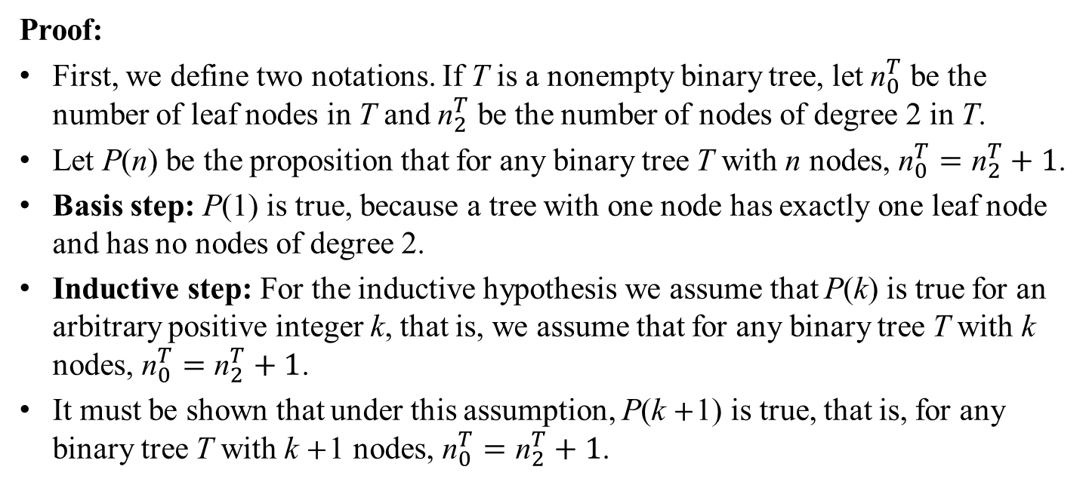
5.2.2 Properties of Binary Trees
Lemma 5.3 [Relation between number of leaf nodes and degree-2 nodes]: For any nonempty binary tree, T, if n₀ is the number of leaf nodes and n₂ the number of nodes of degree 2, then n₀ = n₂ +1.
Proof:
First, we define two notations. If T is a nonempty binary tree, let ${\text{n}}_{0}^{T}$ be the number of leaf nodes in T and ${\text{n}}_{2}^{T}$ be the number of nodes of degree 2 in T.
Let P(n) be the proposition that for any binary tree T with n nodes, ${\text{n}}_{0}^{T}={\text{n}}_{2}^{T}+1$.
Basis step: P(1) is true, because a tree with one node has exactly one leaf node and has no nodes of degree 2.
Inductive step: For the inductive hypothesis we assume that P(k) is true for an arbitrary positive integer k, that is, we assume that for any binary tree T with k nodes, ${\text{n}}_{0}^{T}={\text{n}}_{2}^{T}+1$.
It must be shown that under this assumption, P(k +1) is true, that is, for any binary tree T with k +1 nodes, ${\text{n}}_{0}^{T}={\text{n}}_{2}^{T}+1$.

Slide 29
1
2
3
4
5
6
7
8
9
10
11
12

Slide 30
1
2
3
4
5
6
7
8
9
10
11
12
1
2
3
4
5
6
7
8
9
10
11

Slide 31
1
2
3
4
5
6
7
8
9
10
11
12
1
2
3
4
5
6
7
8
9
10
12

Slide 32
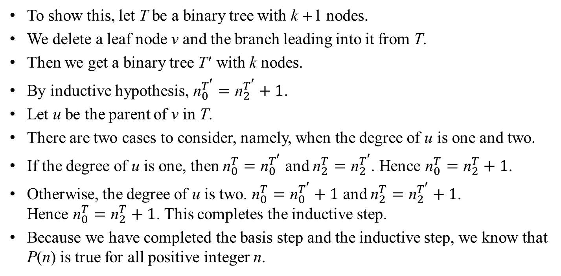
5.2.2 Properties of Binary Trees
Lemma 5.3 [Relation between number of leaf nodes and degree-2 nodes]: For any nonempty binary tree, T, if n₀ is the number of leaf nodes and n₂ the number of nodes of degree 2, then n₀ = n₂ +1.
To show this, let T be a binary tree with k +1 nodes.
We delete a leaf node v and the branch leading into it from T.
Then we get a binary tree T′ with k nodes.
By inductive hypothesis, ${\text{n}}_{0}^{T′}={\text{n}}_{2}^{T′}+1$.
Let u be the parent of v in T.
There are two cases to consider, namely, when the degree of u is one and two.
If the degree of u is one, then ${\text{n}}_{0}^{T}={\text{n}}_{0}^{T′}$ and ${\text{n}}_{2}^{T}={\text{n}}_{2}^{T′}$. Hence ${\text{n}}_{0}^{T}={\text{n}}_{2}^{T}+1$.
Otherwise, the degree of u is two. ${\text{n}}_{0}^{T}={\text{n}}_{0}^{T′}+1$ and ${\text{n}}_{2}^{T}={\text{n}}_{2}^{T′}+1$. Hence ${\text{n}}_{0}^{T}={\text{n}}_{2}^{T}+1$. This completes the inductive step.
Because we have completed the basis step and the inductive step, we know that P(n) is true for all positive integer n.

Slide 33
Full Binary Trees
Definition: A full binary tree of height k is a binary tree of height k having 2^{k} − 1 nodes, k ≥ 0.
1
2
3
4
5
6
7
8
9
10
11
12
13
14
15
Figure 5.11: Full binary tree of depth 4 with sequential node numbers

Slide 34
Complete Binary Trees
Definition: A binary tree with n nodes and height k is complete iff its nodes correspond to the nodes numbered from 1 to n in the full binary tree of height k.
1
2
3
4
5
6
7
8
9
10
11
12

